Slide 1


Presented by Amr Yasser - 202301043
DATA ANALYSIS
ROLES OF DSAI

Slide 2


Introduction to results analysis
Data Analysts focus on interpreting data and providing actionable insights through reports and visualizations. They excel at identifying trends and patterns that help businesses make informed decisions. Data Engineers are responsible for designing, building, and maintaining the infrastructure necessary for data generation, storage, and access. Their work ensures that data is available, reliable, and clean for analysis.
_____________
They ensure that models are robust, efficient, and easily integrated into existing systems. Together, these roles form a cohesive team that harnesses the power of data to drive innovation, enhance efficiency, and provide a competitive edge in today's data-driven world.

Slide 3

Data Analysts
Analytical thinking, attention to detail, communication.
• Tools: Excel, SQL, Tableau, Power BI.’
Typical Projects and Examples:
• Analyzing sales trends to forecast future sales. • Creating dashboards to visualize key performance indicators (KPIs).
• Career Paths and Progression: • Junior Data Analyst → Data Analyst → Senior Data Analyst → Data Analytics Manager.
Definition and Core Responsibilities: Data Analysts are responsible for interpreting data and turning it into information that can offer ways to improve a business, thus affecting business decisions. They collect, process, and perform statistical analyses on large datasets.

Slide 4


Data Engineers
Definition and Core Responsibilities: Data Engineers are responsible for designing, building, and maintaining the data architecture. They ensure that data is accessible, reliable, and secure.
Required Skills and Tools:
Programming, problem-solving, database management.
• Tools: Python, Java, SQL, NoSQL, AWS, Azure.
Typical Projects and Examples:
•Developing and maintaining data pipelines. •
Building data warehouses for large-scale data storage. key performance indicators (KPIs).
• Career Paths and Progression:
Junior Data Engineer → Data Engineer →
Senior Data Engineer → Data Architect.

Slide 5
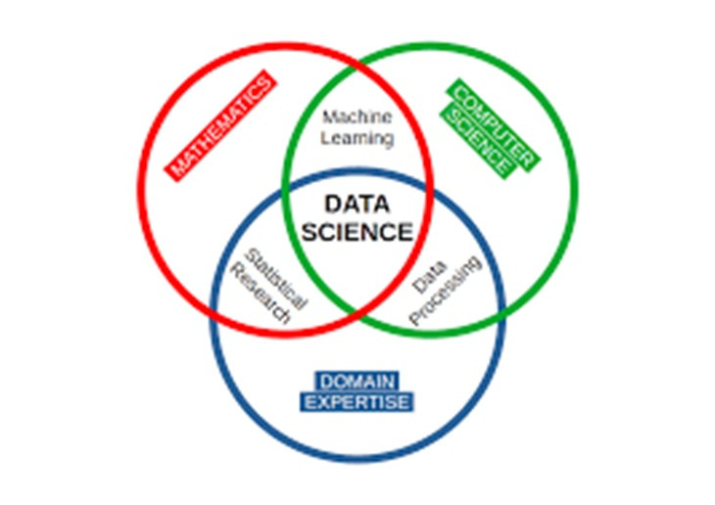
Data Scientists
Required Skills and Tools:
Definition and Core Responsibilities: Data Scientists analyze and interpret complex data to help companies make decisions. They use advanced analytics technologies, including machine learning and predictive modeling.
Statistical analysis, machine learning, data visualization.
• Tools: Python, R, TensorFlow, Scikit-learn.
Statistical analysis, machine learning, data visualization.
• Tools: Python, R, TensorFlow, Scikit-learn.

Slide 6
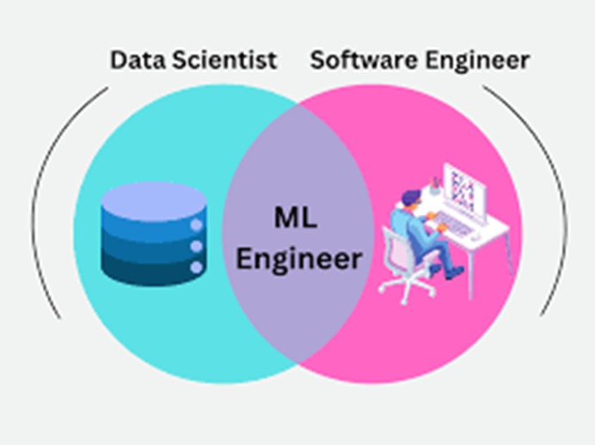
MACHINE LEARNING ENGINEER
Definition and Core Responsibilities: Machine Learning Engineers design and implement machine learning models and systems. They work closely with data scientists to scale models for production.
Required Skills and Tools:
Programming, understanding of ML algorithms, system design.
• Tools: PyTorch, TensorFlow, Scikit-learn.
Typical Projects and Examples: •
Developing recommendation systems for e-commerce platforms. •
Creating image recognition models for automated tagging.
• Career Paths and Progression: Junior ML Engineer → ML Engineer → Senior ML Engineer → ML Architect.

Slide 7
MACHINE LEARNING OPERATIONS (MLOPS) ENGINEER
Definition and Core Responsibilities:
MLOps Engineers focus on the deployment, monitoring, and scaling of machine learning models. They ensure that models are production-ready and maintain their performance over time.
Required Skills and Tools:
DevOps practices, automation, monitoring.
• Tools: Docker, Kubernetes, Jenkins, CI/CD pipelines.
Typical Projects and Examples: • Automating the deployment of ML models
. • Monitoring model performance and retraining as necessary.
• Career Paths and Progression: MLOps Engineer → Senior MLOps Engineer → MLOps Lead.

Slide 8

COMPARISON AND OVERLAPS
both Data Scientists and Machine Learning Engineers need strong programming skills and knowledge of machine learning frameworks.
Data Scientists and MLOps Engineers, to ensure models are effectively deployed and maintained.
Data Analysts and Data Scientists often work together during the data exploration phase, sharing insights and leveraging each other's expertise to uncover meaningful patterns.

Slide 9

CONCLUSION
The data field offers diverse career opportunities, each playing a vital role in leveraging data for business success. As data continues to grow in importance, these roles will evolve, offering new challenges and opportunities for professionals in the field. The fields of data analysis, engineering, science, and visualization offer immense potential for growth and innovation. Keeping abreast of the latest tools and methodologies is essential, given the rapid advancements in technology.

Slide 10

Presented by Sandra Haro
Thank you very much!
www.reallygreatsite.com

